Slide 1



No Cheat Zone Application
Presented by:
Lingamgari Charan Teja (228P1A0526)
Pallerla Nani (228P1A0539)
Sangyapu Charatn Kumar (228P1A0544)

Slide 2

Introduction to No Cheat Zone
The rapid growth of online education and remote examinations has created unprecedented challenges in maintaining exam integrity. Traditional invigilation methods fail to translate effectively to digital environments, while existing proctoring solutions raise serious privacy concerns.
Cloud-Heavy Privacy Concerns
No Real-Time Control
Current proctoring tools collect excessive student data, creating security vulnerabilities and compliance challenges
Examiners lack live oversight capabilities, preventing immediate intervention during suspicious activities
Online Security Concerns
Many regions suffer from a lack of security issues in their Internet access, necessitating lightweight, online-compatible solutions.

Slide 3
Problem Statement
The digital examination landscape faces critical gaps that compromise both security and accessibility.
Lack of Effective Prevention
Privacy Concerns
Current systems fail to prevent cheating through app switching, external help, and unauthorized collaboration during exams
Cloud-based solutions collect excessive personal data, raising compliance issues under privacy regulations like GDPR and FERPA
No Real-Time Control
Offline Capability Needed
Examiners cannot monitor sessions live or intervene immediately when violations occur, reducing effectiveness
Many students lack reliable internet access, requiring solutions that work offline while maintaining security

Slide 4

Literature Survey
Our research examined existing proctoring systems, AI-based monitoring tools, and cheating detection techniques to identify critical gaps in current approaches.
Key Findings
Cloud-based vs. device-based proctoring trade-offs
ML models for face recognition and activity detection
Privacy-integrity balance challenges
Scalability issues in large-scale exams
Mobile-first solution opportunities

Slide 5





Proposed System
An Android-based secure exam platform that combines real-time monitoring with privacy-focused design.
Android Platform
Real-Time Monitoring
App Lockdown
Mobile-first deployment ensures accessibility and scalability across diverse student populations
Continuous camera and activity tracking with AI-driven face recognition and behavior analysis
Prevents background processes and app switching during exam sessions
Host Control
Privacy Focused
Examiners maintain live oversight and session management throughout testing
Minimal data collection with device-based processing prioritizing student privacy

Slide 6





System Architecture
Student Application
Secure exam interface with camera and activity monitoring
Monitoring Module
AI-driven face and activity detection
Socket Communication
Real-time, secure data transfer
Alert & Logging
Violation recording and alert generation
Host Application
Live supervision and exam control

Slide 7





Module Description
Student Module
Host Module
Monitoring Module
Creates restricted environment preventing app switching and ensuring continuous camera monitoring throughout exams
Enables exam management, live feed viewing, and instant violation alerts for proactive oversight
Detects suspicious behavior including multiple faces, absence from camera view, and abnormal activity patterns
Communication Module
Logging Module
Maintains socket-based encrypted channels for low-latency data exchange between student and host
Maintains comprehensive violation logs for post-exam review and accountability purposes

Slide 8
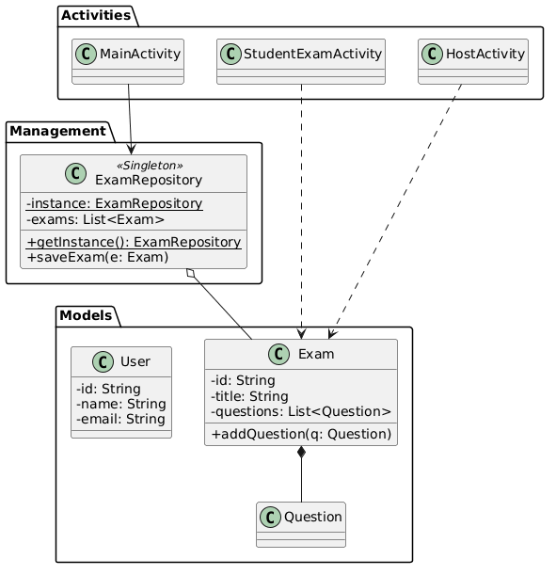
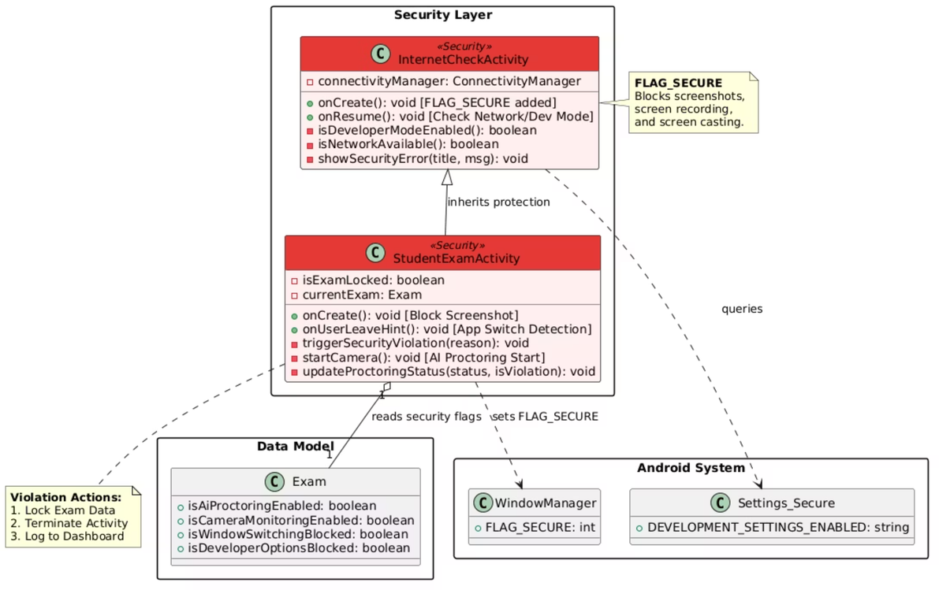
UML Diagrams

Slide 9
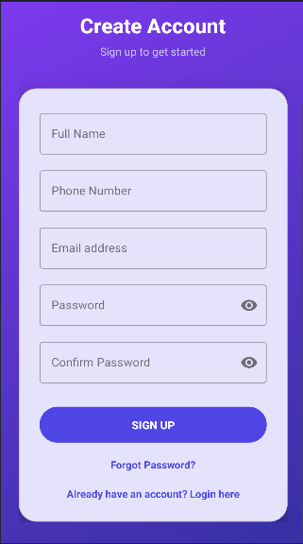
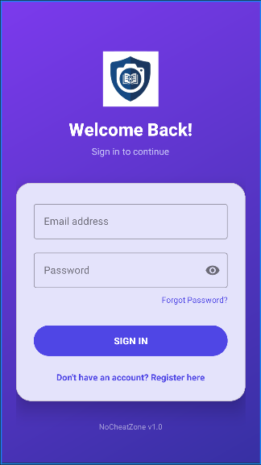
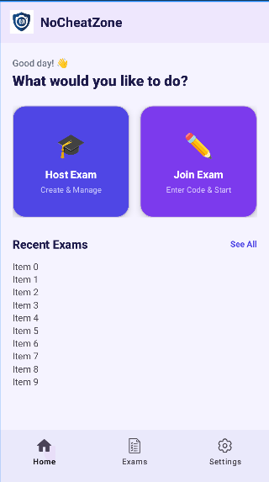
Implementation - Common Activities

Slide 10
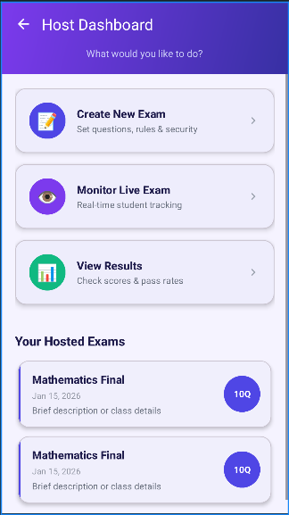
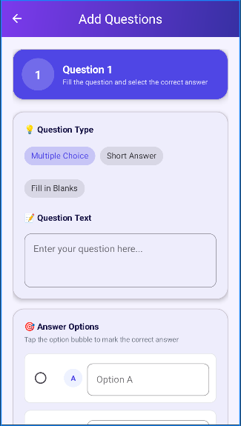
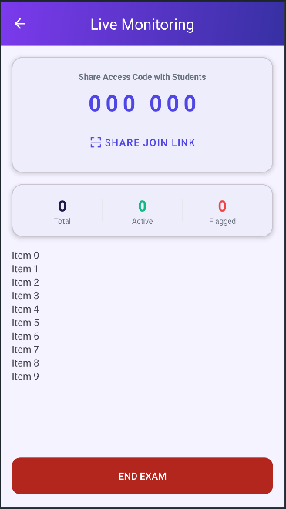
Host Activities

Slide 11
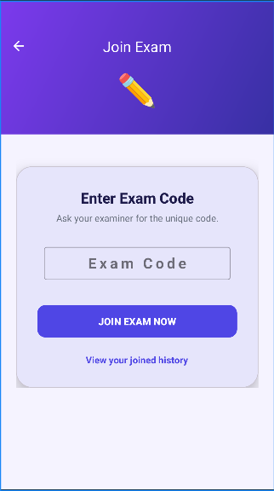
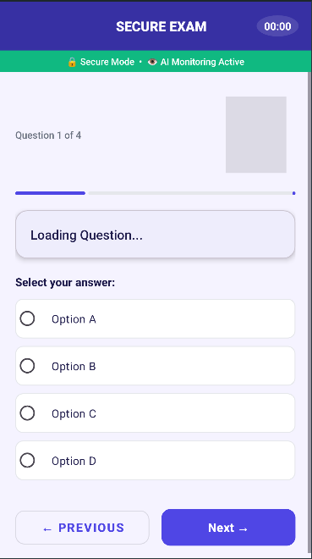
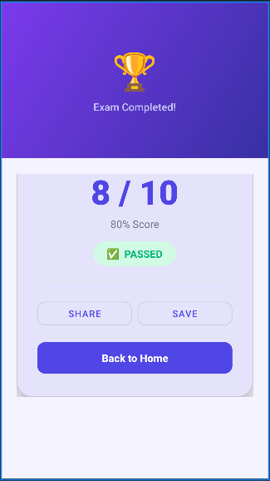
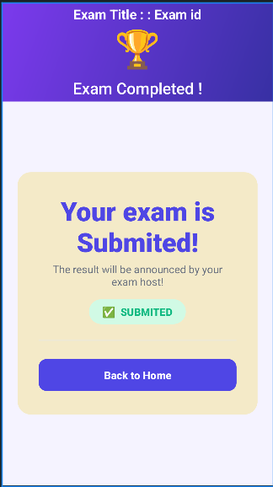
Student Activities

Slide 12
Advantages
Ensures fairness
Improves genuine learning
Saves time for teachers
Advanced monitoring
Equal opportunities for all students
Encourages self-study and discipline
Automated invigilation reduces manual supervision
Screen monitoring, webcam proctoring, tab-switch detection, AI-based suspicious behaviour tracking

Slide 13
Limitations
Platform & Ecosystem
Question Type Constraints
Security Boundaries
Performance & Hardware Stress
Android-only support with OS dependency issues across versions.
Designed for MCQs; no support for essays, coding, or image-based answers.
Rooted devices may bypass restrictions, and external hardware use cannot be fully prevented.
Can cause battery drain and overheating, and depends on internet connectivity for Firebase sync.

Slide 14
Future Scope
1
2
3
Cheat Detection & Security Engine
AI & ML Integration
Real-Time Host Monitoring Interface
Features: Face detection & tracking, object detection (smartphones, books), gaze tracking, multiple person detection
Applications: Corporate recruitment, academic assessments
Dashboard with live status stream and violation alerts

Slide 15
Conclusion
No Cheat Zone at a Glance
Key Impact
Security with Privacy
Future Potential
By identifying suspicious behavior and reducing opportunities for cheating, the system addresses one of the biggest challenges in digital assessments: preserving trust in the evaluation process.
With continued adoption, No Cheat Zone can help transform digital education by making remote exams more credible, scalable, and equitable.
No Cheat Zone is designed to strengthen online exam integrity with intelligent monitoring, real-time detection, and actionable alerts that help maintain fairness at scale.
It balances strong proctoring capabilities with responsible monitoring practices, aiming to protect exam security while respecting user privacy.

Slide 16





Key Benefits
Enhanced Exam Integrity
Student Privacy Protection
Our system prevents cheating through real-time monitoring and app lockdown, ensuring fair and credible assessment results.
Designed with privacy in mind, it minimizes data collection and processes sensitive information on-device, adhering to global regulations.
Real-Time Oversight
Scalable Solution
Examiners gain live control and instant alerts, allowing proactive intervention to maintain exam security and respond to incidents.
Leveraging an Android-first approach, the platform supports large student populations and diverse regions, including those with limited internet access.
Cost-Effective Implementation
By utilizing existing mobile devices and efficient resource management, it offers a more economical proctoring solution compared to traditional methods.

Slide 17




Next Steps & Implementation
Pilot Testing
Refinement
Launch with select institutions to gather critical user feedback and performance data in real-world scenarios.
Iteratively enhance features, optimize performance, and fine-tune AI models based on comprehensive pilot feedback.
Deployment
Continuous Improvement
Roll out the full platform to a broader range of educational institutions and corporate training partners.
Regularly monitor system performance, update AI algorithms, and introduce new functionalities to stay ahead of evolving needs.

Slide 18

Thank You
We sincerely thank you for your time and attention today. We hope this presentation has effectively showcased the innovative capabilities of the "No Cheat Zone" system.
Lingamgari Charan Teja (228P1A0526)
Pallerla Nani (228P1A0539)
Sangyapu Charatn Kumar (228P1A0544)
Our vision is to build a future where digital examinations are universally secure, fair, and respectful of student privacy, ensuring the integrity and credibility of online learning.

